Slide 1
PID-Controlled Ball Balancing System
Controlled by MATLAB + Simulink + Arduino
Students: Maria Luiza Cabral, Philip Pham, Gerald Springstead and Jordan Nance.
Professor: Pallavi Singh
Class: EEL3013.82833

Slide 2
Project Overview
The goal of this project is to design and implement a PID-controlled Ball Balancing System.
The system stabilizes a ball on a beam using real-time feedback.
MATLAB and Simulink are used for modeling, simulation, and PID tuning.
Arduino Uno executes the control logic in real time.
The project demonstrates practical applications of closed-loop control.

Slide 3
System Objective
Maintain the ball at a defined setpoint on the beam.
Measure ball position using an ultrasonic sensor.
Use a PID controller to compute corrective beam angles.
Control the servo motor to adjust the beam’s tilt.
Analyze the performance of the controller after tuning.

Slide 4
Components Used
Hardware:
Arduino Uno
HC-SR04 ultrasonic sensor
MG996R servo motor
Wooden or acrylic beam
Steel/plastic ball
Jumper wires
Software:
MATLAB
Simulink
Arduino Support Package

Slide 5
Working Principle
The ultrasonic sensor measures the ball’s position in real time.
Simulink compares the position to the setpoint.
The PID controller calculates the required correction.
The Arduino drives the servo motor.
The beam tilts, causing the ball to move.
The cycle repeats continuously in a closed loop.

Slide 6
Simulink Model
Includes Ultrasonic Sensor block, Signal Scaling, PID Controller, and Servo Write block.
The sampling time is set to 0.02 s for smooth control.
PID tuning was performed experimentally using proportional-only, then PD, and finally full PID control.
Final parameters used:
Kp = 1.75
Ki = 0.20
Kd = 0.18

Slide 7
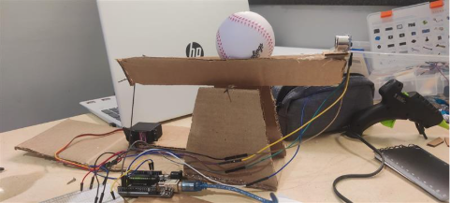

Slide 8
Hardware Implementation
Beam mounted on a servo motor
Ultrasonic sensor positioned at beam end
Arduino connected to MATLAB via USB
Real-time tuning performed during operation

Slide 9
Conclusion
The project successfully demonstrated real-time PID control using MATLAB and Arduino.
The Ball Balancing System provided hands-on experience with closed-loop dynamics.
The results confirm the controller’s ability to stabilize an inherently unstable system.
Future improvements may include filtering sensor data, using a higher-quality servo, or applying advanced control methods.

